Slide 1
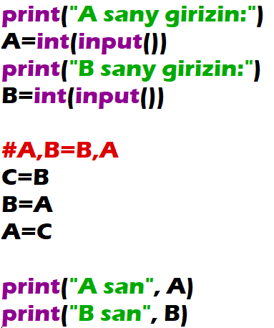
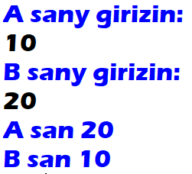
Exchange the values of two given variables A and B. Output the new values of A and B.

Slide 2
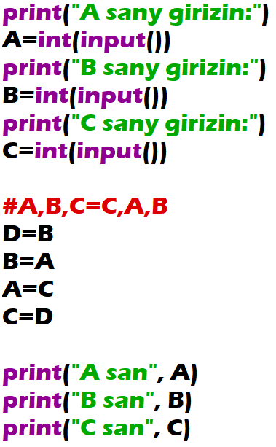
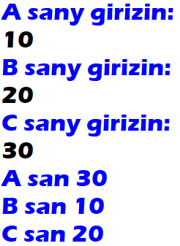
Variables A, B, C are given. Change values of the variables by moving the given value of A into the variable B, the given value of B into the variable C, and the given value of C into the variable A. Output the new values of A, B, C.

Slide 3
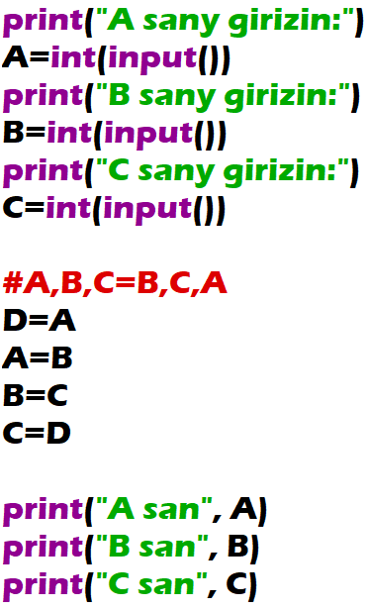
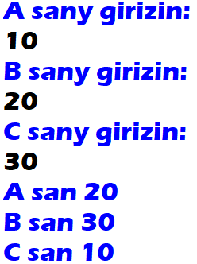
Variables A, B, C are given. Change values of the variables by moving the given value of A into the variable C, the given value of C into the variable B, and the given value of B into the variable A. Output the new values of A, B, C.

